Slide 1
Reliable Transport
TCP Review
CS144 Review Session 1
October 2, 2008
Roger Liao
Slides Credit: Ben Nham

Slide 2
Announcements
Labs 1 and 2 are online
Lab 1 due 10/8 @ beginning of class
Come to lecture → free extension to midnight
Contact us before the deadline if you need an additional extension. Tell us:
  Where you are
  How much more time you need

Slide 3
Lab 1 Overview
Stop and wait
One connection only
Connect on same machine or different machines (myth)
Specify correct ports (>= 1024)
Quick Lab 1 Demo!

Slide 4
Client-Server File Transfer
Suppose Blizzard wants to distribute a patch for WoW
  Patch size is 450 MB = 3600 Mbits
  Need to distribute patch to 5 million players over 5 hours
  How many 100 MBps servers are needed?
3600 Mbits * 5 million / 5 hours = 1*10¹² bps
1*10¹² bps / 100 Mbps = 10000 servers

Slide 5
Peer to Peer File Transfer
Use one 100 Mbps server, and suppose each client has a 1Mbps full-duplex link
Split the patch into 450 chunks, 1MB each
Then:
  Seed each chunk to one client each
  Wait for every client to get at least one chunk
  Wait for every client to acquire the other 449 chunks

Slide 6
Seeding
Server
100 Mbps
Seed each chunk to one client each
450 * 1 MB / 100 Mbps = 1 min to seed

Slide 7
Exponential Growth
B
A
A
Wait for every client to get at least one chunk
We have 450 seed clients with 1 Mbps links
  5 million clients / 450 seeds = 11112 clients/seed
  This distribution takes place exponentially:
    ceil(log₂ 11112) = 14 time steps
    Each time step is 1 MB / 1 Mbps = 8 s
    Total time: 14 * 8 s = 2 minutes

Slide 8
Exponential Growth
B
D
B
A
A
C
A
Wait for every client to get at least one chunk
We have 450 seed clients with 1 Mbps links
  5 million clients / 450 seeds = 11112 clients/seed
  This distribution takes place exponentially:
    ceil(log₂ 11112) = 14 time steps
    Each time step is 1 MB / 1 Mbps = 8 s
    Total time: 14 * 8 s = 2 minutes

Slide 9
Exponential Growth
B
D
B
H
F
D
B
A
A
C
A
G
E
C
A
Wait for every client to get at least one chunk
We have 450 seed clients with 1 Mbps links
  5 million clients / 450 seeds = 11112 clients/seed
  This distribution takes place exponentially:
    ceil(log₂ 11112) = 14 time steps
    Each time step is 1 MB / 1 Mbps = 8 s
    Total time: 14 * 8 s = 2 minutes

Slide 10
Peak Transfer
Now each client has a single chunk
Everyone can utilize their full 1Mbps connection
For any client, takes 449 * 8s = 1 hour to download the rest of the chunks in the patch
Adding up:
  Seeding takes 1 minute
  Exponential growth until everyone has a chunk takes 2 min
  Finishing transfer takes 1 hour
  1 min + 2 min + 1 hour << 5 hours
  1 server << 10000 servers

Slide 11
Layering Review
Application |  | Data
↓ |  | ↓
Transport |  | Data | TCP/UDP Header
↓ |  | ↓
Network |  | Data | TCP/UDP Header | IP Header
↓ |  | ↓
Link |  | Data | TCP/UDP Header | IP Header | Ethernet Header

Slide 12
TCP Overview
Network layer protocol
Properties
  Full-duplex connection
    Two-way communication between (IP, port)_{src} and (IP, port)_{dst}
    Connection setup before any transfer
    Connection teardown after transfer finishes
    Each connection creates state in sending and receiving hosts
  Reliable: resends lost/corrupted segments
  In-order: buffers at sender and receiver
  Stream of bytes: looks like a file you can R/W to

Slide 13
TCP Segments
IP Data
Provide illusion of a stream of bytes, but we actually are going over a datagram network using packets (IP)
Data is carried in TCP segments and placed into an IP packet
TCP Data
TCP
Hdr
IP Hdr
0
15
31
Src port
Dst port
Sequence #
Ack Sequence #
HLEN
4
RSVD
6
FIN
Window Size
SYN
URG
RST
ACK
PSH
Checksum
Urg Pointer
(TCP Options)
TCP Data
Credit: CS244A Handout 8

Slide 14
Sequence Numbers
ISN (initial sequence number)
Host A
Seq number = First byte of segment
TCP Data
TCP
Hdr
Ack seq number = next expected byte
TCP Data
TCP
Hdr
Host B
Credit: CS244A Handout 8

Slide 15
Three-Way Handshake
Exchange initial sequence numbers at connection startup
  Client’s ISN = x
  Server’s ISN = y
Send a special segment with SYN bit set (“synchronize”)
SYN takes up one “byte”
Client
Server
SYN
SEQ = x
SYN/ACK
SEQ = y, ACK = x+1
ACK = y+1

Slide 16
Shutdown
Either side can initiate shutdown
Can shutdown only one side of connection, if desired
TIME_WAIT state to handle case of whether last ACK was lost
FIN
SEQ = v
ACK
ACK = v+1
FIN
SEQ = w
ACK = w+1

Slide 17
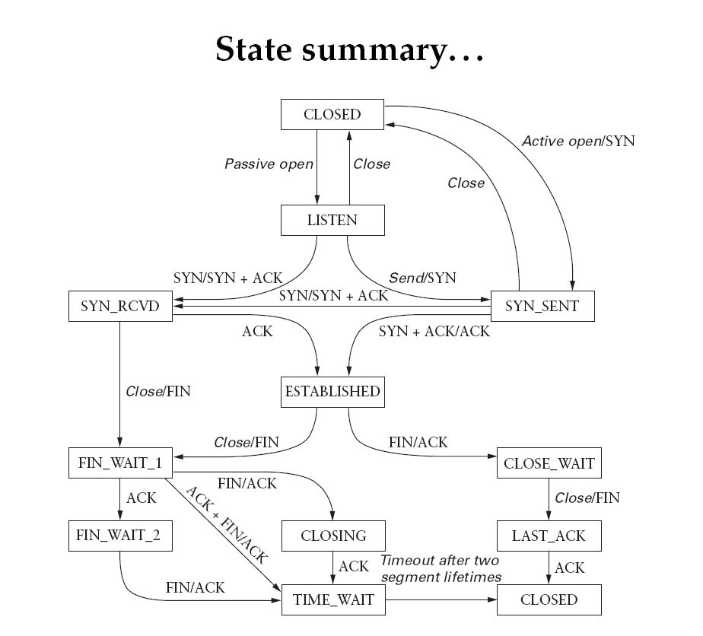

Slide 18
Example
Start
Client connect
Server Listening
Server waits for client ACK of connection request
Client waits for ACK of connection request
Client and Server communicate. Ex: (GET req)
Server closes connection after GET request
Client ACKs server FIN. It then sends FIN
Server receives client FIN and ACKs. It waits for ACK of its own FIN
Server receives client ACK
Client receives ACK of its own FIN
Server receives client FIN and ACKs it

Slide 19
Practice Questions
Review questions at end of each chapter
Midterm/final are conceptual
Practice problems at section

Slide 20
Question:
Consider a new peer Alice that joins BitTorrent without possessing any chunks. Without any chunks, she cannot become a top-four uploader for any of the other peers, since she has nothing to upload. How then will Alice get her first chunk?

Slide 21
Answer:
Every 30 seconds, BitTorrent peers randomly unchoke their peers and send data.
Eventually, Alice will be unchoked by a peer and will receive her first chunk, enabling her to trade with others.

Slide 22
Question:
In BitTorrent, suppose Alice provides chunks to Bob throughout a 30-second interval. Will Bob necessarily return the favor and provide chunks to Alice in this same interval? Why or why not?

Slide 23
Answer:
Not necessarily.
Bob only supplies data to his top four peers and a random fifth peer.
Suppose Alice does not supply data at a high enough rate to beat Bob’s top four peers. Then, Bob will not be satisfied with the trading and will not send data in return.

Slide 24
Question:
Suppose Host A sends two TCP segments back to back to Host B over a TCP connection. The first segment has sequence number 90; the second has sequence number 110.
a. How much data is in the first segment?
b. Suppose that the first segment is lost but the second segment arrives at B. In the acknowledgement that Host B sends to Host A, what will be the acknowledgement number?

Slide 25
Answer:
a. 20 bytes. Bytes 90-109 are in the first segment.
b. 90. TCP uses cumulative acks, so even if it buffers the second segment, the ack is still for the first segment.

Slide 26
Extra Practice:
Chapter 2
  R6, R10, P1
Chapter 3
  R3, R4, R7, P3, P5, P20,P24

