Slide 1
Physical and Link Layers
CS144 Review Session 6
November 6th, 2008
Roger Liao
Based on slides by Ben Nham

Slide 2
Outline
Physical layer
  Encoding of signals
  Chips vs. bits
Link layer
  Communication through shared medium
  Hubs vs. switches

Slide 3
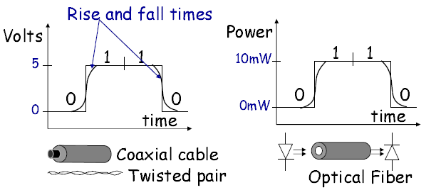
Signaling bits on a link
Most electrical and optical networks signal bits using two distinct voltage/power levels.

Slide 4
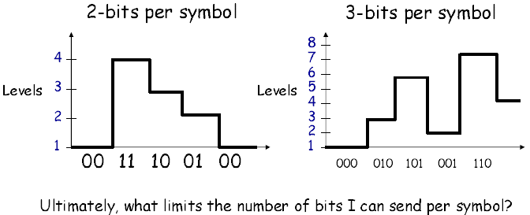
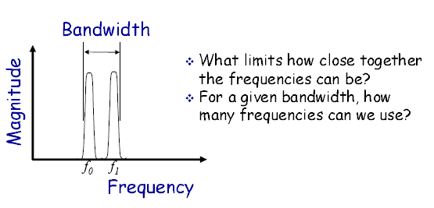
Coding schemes
Multilevel encoding
Frequency division multiplexing
High speed links use a selection of complicated techniques to squeeze maximum data-rate from link
Capacity – maximum data rate of a link

Slide 5
Manchester Encoding
Synchronous digital systems need a clock to trigger sampling of data
Manchester encoding allows us to encode the clock with the data stream
  The preamble to the Ethernet frame is used to synchronize the sender clock with the receiver clock
In Manchester encoding:
  Transmitter samples data on edge of clock (usually rising edge)
  If we sample a 1, it is encoded by a rising edge
  If we sample a 0, it is encoded by a falling edge

Slide 6
Manchester Encoding Question
Suppose a 10Mbps NIC sends into a link an infinite stream of zeros using Manchester encoding. The signal emerging from the adapter will have how many transitions per second?
  2 transitions per bit time
  Bit times occur at clock frequency of 10MHz
  Transitions occur at 20 MHz
clk
data
encoding

Slide 7
Chips and Bits
Chips – 1’s and 0’s at physical layer
Bits – Actual data
Encoded for:
  Clock encoding
  Error detection
  Error correction
Example
Straw man example 1
  Duplicate bits
  Bits: 101
  Chips: 110011
  Now we can detect one bit errors (100011 – invalid!)
Straw man example 2
  Triplicate bits
  Bits: 101
  Chips: 111000111
  Now we can correct one bit errors (101000111 – guess that the second bit is flipped)
In reality the physical layer does more efficient encodings but gets similar benefits

Slide 8
Arbitration of Shared Resources
General systems problem
  I have a shared resource that only one person can use at a time
  How do I arbitrate access to it?
Shared CPU, multiple processes need it – OS scheduler
Shared radio spectrum, multiple broadcasters – frequency division multiplexing
One Ethernet coax, multiple clients connected to it – CSMA/CD
  Other ways of sharing a medium, e.g. Token Ring, Aloha, etc. in book

Slide 9
CSMA/CD in the Classroom
We are students sharing the air in this room, and develop the following protocol to arbitrate access to it:
  Before I talk, I see if anyone else is talking
  If anyone else is talking, don’t talk
  If no one else is talking, start talking
  If I start talking and sense that someone else has started talking, stop talking, and start talking some random time that increases exponentially to hope that no one is talking then

Slide 10
CSMA/CD in Ethernet
We are nodes sharing this Ethernet wire, and develop the following protocol to arbitrate access to it:
  Before I send, I sense the wire to see if anyone else is sending
  If anyone else is sending, don’t send
  If no one else is sending, start sending
  If I start sending and sense that someone else has started sending, stop sending, and start sending after waiting some random time that increases exponentially, to hope that no one is sending then
  This is why CSMA/CD is known as an “exponential backoff” algorithm

Slide 11

CSMA/CD Network Size Restriction
To ensure that a packet is transmitted without a collision, a host must
be able to detect a collision before it finishes transmitting a packet.
A
“Line is idle”
“Line is idle”
B
t=PROP--
t=PROP-
t=0
t=PROP
t=2PROP-
PROP
PROP
Events:
t=0: Host A starts transmitting a packet.
t=PROP--: Just before the first bit reaches Host B,
Host B senses the line to be idle and starts
to transmit a packet.
t=PROP-: A collision takes place near Host B.
t=PROP: Host B receives data whilst transmitting, and
so detects the collision.
t=2PROP-: Host A receives data whilst transmitting, and
so detects the collision.

Slide 12
Length Limitation of CSMA/CD
There is a minimum size frame needed to be able to detect collisions:
  Transmission Delay > 2 * Propagation Delay
  Transmission Delay = MinSize / TransferRate
  MinSize = TransferRate * 2 * Propagation Delay
Longer wire = larger prop delay = larger MinSize
Faster transfer rate = larger MinSize
  Serious problem with Gigabit Ethernet and higher
  Punt problem by saying that everyone is using switched networks anyway and not going to get collisions

Slide 13
Routers, Switches, and Hubs
Routers are network layer devices
  Modify IP datagram (decrement TTL)
  Hosts and other routers must be aware of them
Switches and hubs are link layer devices
  Only care about frames, don’t modify IP datagram
  Transparent to network

Slide 14
Hubs
Operate as a repeater
  Broadcast an incoming frame to all ports, except for the ingress port
  Like having a longer Ethernet cable that all the hosts tap into
  All ports are on single collision domain!
Advantages: simple, restores signal, potentially fast since we don’t have to buffer or examine frame
Disadvantages: poor bandwidth due to collisions

Slide 15
Hub Question 1
A 10-port hub is connected to 10 hosts using gigabit links. What is the maximum aggregate transfer rate of data flowing through this network?
  All ports are part of the same collision domain--only one device can send at a time
  Therefore, peak bandwidth is one gigabit

Slide 16
Hub Question 2
Recall that 100Mbps Ethernet restricts cable lengths to 100m. Suppose we want to connect two hosts which are 1000m apart. Can we use 10 100m cables with 9 hubs in series to accomplish this?
  No. Since all ports are on same collision domain, max network diameter (1km) is too large to meet the TRANSP > 2 * PROP constraint of CSMA/CD
  In reality, the IEEE standard limits number of hubs in series and specifies maximum network diameter

Slide 17
Switches
Must store and examine frame before forwarding
Simple learning protocol—no configuration
  Given incoming frame (MAC_{src}, MAC_{dst}) on port x:
  Add (MAC_{src}, x) to switch table
  Look up port for MAC_{dst} for in switch table
    If entry is there, forward frame to that port
    Else, broadcast frame to all ports (except ingress port)
  Runs spanning tree protocol to prevent loops
Collision domain is a single port—switch will make sure that the frame it sends out does not collide with another frame being sent on the same link

Slide 18
NAT Preview
Lab 5 is NAT
Implement subset of NAT requirements
Layered on top of sr
  Means you will be on VNS again

