Slide 1
Advanced File Systems
CS 140 – Nov 4, 2016
Ali Jose Mashtizadeh

Slide 2
Outline
FFS Review and Details
Crash Recoverability
Soft Updates
Journaling
Copy-on-Write: LFS/WAFL/ZFS

Slide 3
Review: Improvements to UNIX FS
Problems with original UNIX FS
  512 B blocks
  Free blocks in linked list
  All inodes at the beginning of the disk
UNIX Performance Issues
  Transfers 512 B per disk IO
  Fragmentation leads to 512 B/average seek
  Inodes far from directory and file data
  Files within directory scattered everywhere
Useability Issues
  14 character file names
  not crash proof

Slide 4
Review: Fast File System [McKusic]
Variable block size (at least 4 KiB)
  Fragment technique reduced wasted space
Cylinder groups spread inodes around disk
Bitmap for fast allocation
FS reserves space to improve allocation
  Tunable parameter default 10%
  Reduces fragmentation
Usability improvements:
  255 character file names
  Atomic rename system call
  Symbolic links

Slide 5
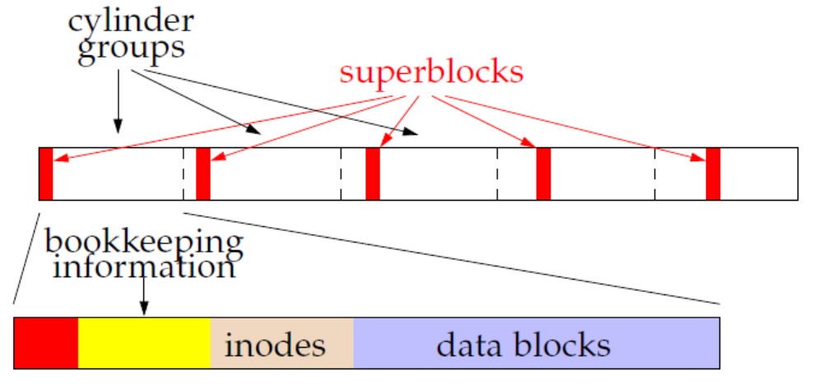
Review: FFS Disk Layout
Each cylinder group has its own:
  Superblock
  Cylinder Block: Bookkeeping information
  Inodes, Data/Directory blocks

Slide 6
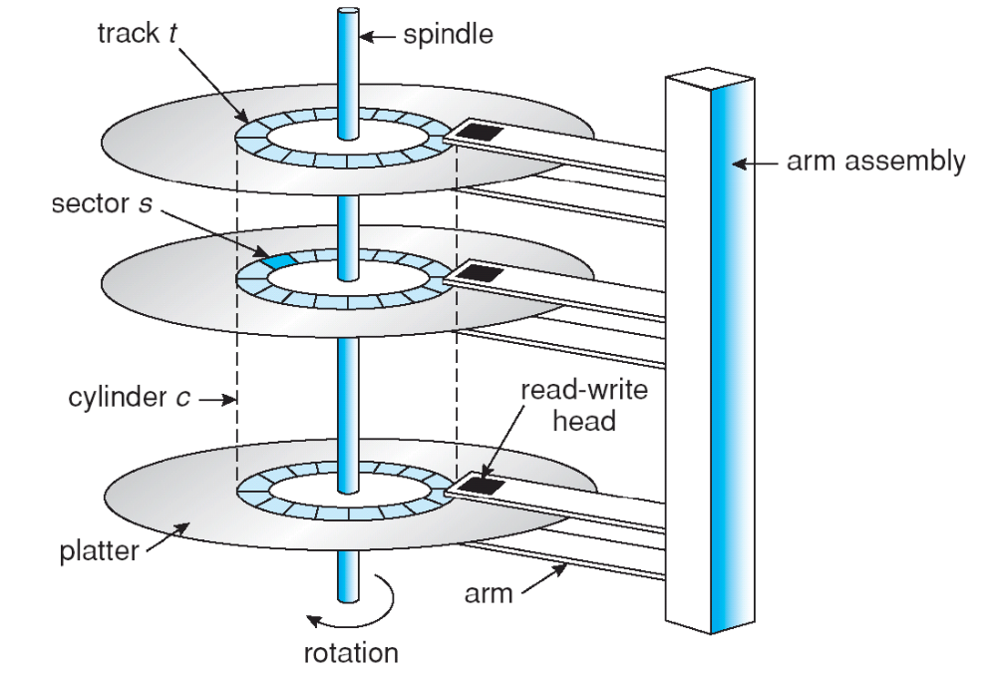
Cylinders, tracks, and sectors

Slide 7
Superblock
Contains file system parameters
  Disk characteristics, block size, Cyl. Group info
  Information to locate inodes, free bitmap, and root dir.
Replicated once per cylinder group
  At different offsets to span multiple platters
  Contains magic number 0x00011954 to find replica’s
  (McKusick’s birthday)
Contains non-replicated information (FS summary)
  Number of blocks, fragments, inodes, directories
  Flag stating if the file system was cleanly unmounted

Slide 8
Bookkeeping information
Block map
  Bitmap of available fragments
  Used for allocating new blocks/fragments
Summary info within CG (Cylinder Group Block)
  # of free inodes, blocks/frags, files, directories
  Used when picking which cyl. group to allocate into
# of free blocks by rotational position (8 positions)
  Reasonable when disks were accessed with CHS
  OS could use this to minimize rotational delay

Slide 9
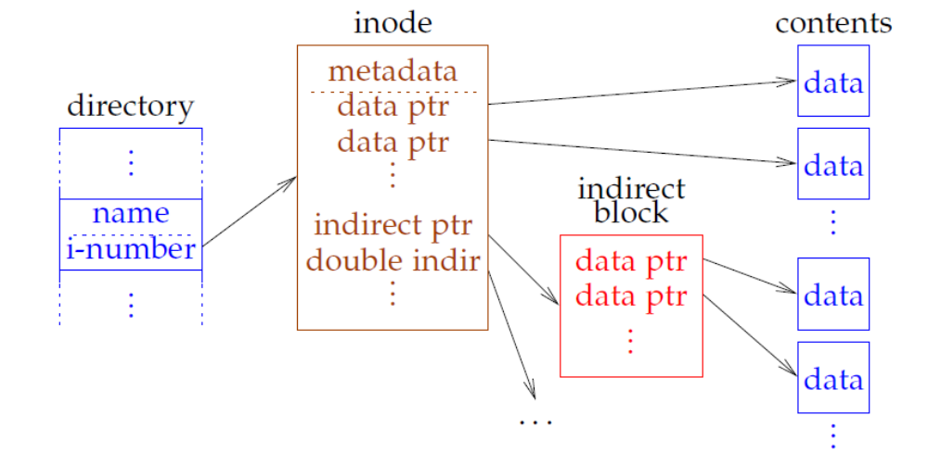
Inodes and Data blocks
Each CG has fixed # of inodes
Each inode maps offset to disk block for one file
Inode contains metadata

Slide 10
On-Disk Inode
struct ufs1_dinode {
u_int16_t di_mode; /* 0: IFMT, permissions; see below. */
int16_t di_nlink; /* 2: File link count. */
uint32_t di_freelink; /* 4: SUJ: Next unlinked inode. */
u_int64_t di_size; /* 8: File byte count. */
int32_t di_atime; /* 16: Last access time. */
int32_t di_atimensec; /* 20: Last access time. */
int32_t di_mtime; /* 24: Last modified time. */
int32_t di_mtimensec; /* 28: Last modified time. */
int32_t di_ctime; /* 32: Last inode change time. */
int32_t di_ctimensec; /* 36: Last inode change time. */
ufs1_daddr_t di_db[NDADDR]; /* 40: Direct disk blocks. */
ufs1_daddr_t di_ib[NIADDR]; /* 88: Indirect disk blocks. */
u_int32_t di_flags; /* 100: Status flags (chflags). */
u_int32_t di_blocks; /* 104: Blocks actually held. */
u_int32_t di_gen; /* 108: Generation number. */
u_int32_t di_uid; /* 112: File owner. */
u_int32_t di_gid; /* 116: File group. */
u_int64_t di_modrev; /* 120: i_modrev for NFSv4 */
};

Slide 11
On-Disk Inode: POSIX Permissions
struct ufs1_dinode {
u_int16_t di_mode; /* 0: IFMT, permissions; see below. */
int16_t di_nlink; /* 2: File link count. */
uint32_t di_freelink; /* 4: SUJ: Next unlinked inode. */
u_int64_t di_size; /* 8: File byte count. */
int32_t di_atime; /* 16: Last access time. */
int32_t di_atimensec; /* 20: Last access time. */
int32_t di_mtime; /* 24: Last modified time. */
int32_t di_mtimensec; /* 28: Last modified time. */
int32_t di_ctime; /* 32: Last inode change time. */
int32_t di_ctimensec; /* 36: Last inode change time. */
ufs1_daddr_t di_db[NDADDR]; /* 40: Direct disk blocks. */
ufs1_daddr_t di_ib[NIADDR]; /* 88: Indirect disk blocks. */
u_int32_t di_flags; /* 100: Status flags (chflags). */
u_int32_t di_blocks; /* 104: Blocks actually held. */
u_int32_t di_gen; /* 108: Generation number. */
u_int32_t di_uid; /* 112: File owner. */
u_int32_t di_gid; /* 116: File group. */
u_int64_t di_modrev; /* 120: i_modrev for NFSv4 */
};

Slide 12
On-Disk Inode: Hard Link Count
struct ufs1_dinode {
u_int16_t di_mode; /* 0: IFMT, permissions; see below. */
int16_t di_nlink; /* 2: File link count. */
uint32_t di_freelink; /* 4: SUJ: Next unlinked inode. */
u_int64_t di_size; /* 8: File byte count. */
int32_t di_atime; /* 16: Last access time. */
int32_t di_atimensec; /* 20: Last access time. */
int32_t di_mtime; /* 24: Last modified time. */
int32_t di_mtimensec; /* 28: Last modified time. */
int32_t di_ctime; /* 32: Last inode change time. */
int32_t di_ctimensec; /* 36: Last inode change time. */
ufs1_daddr_t di_db[NDADDR]; /* 40: Direct disk blocks. */
ufs1_daddr_t di_ib[NIADDR]; /* 88: Indirect disk blocks. */
u_int32_t di_flags; /* 100: Status flags (chflags). */
u_int32_t di_blocks; /* 104: Blocks actually held. */
u_int32_t di_gen; /* 108: Generation number. */
u_int32_t di_uid; /* 112: File owner. */
u_int32_t di_gid; /* 116: File group. */
u_int64_t di_modrev; /* 120: i_modrev for NFSv4 */
};

Slide 13
On-Disk Inode: Block Pointers
struct ufs1_dinode {
u_int16_t di_mode; /* 0: IFMT, permissions; see below. */
int16_t di_nlink; /* 2: File link count. */
uint32_t di_freelink; /* 4: SUJ: Next unlinked inode. */
u_int64_t di_size; /* 8: File byte count. */
int32_t di_atime; /* 16: Last access time. */
int32_t di_atimensec; /* 20: Last access time. */
int32_t di_mtime; /* 24: Last modified time. */
int32_t di_mtimensec; /* 28: Last modified time. */
int32_t di_ctime; /* 32: Last inode change time. */
int32_t di_ctimensec; /* 36: Last inode change time. */
ufs1_daddr_t di_db[NDADDR]; /* 40: Direct disk blocks. */
ufs1_daddr_t di_ib[NIADDR]; /* 88: Indirect disk blocks. */
u_int32_t di_flags; /* 100: Status flags (chflags). */
u_int32_t di_blocks; /* 104: Blocks actually held. */
u_int32_t di_gen; /* 108: Generation number. */
u_int32_t di_uid; /* 112: File owner. */
u_int32_t di_gid; /* 116: File group. */
u_int64_t di_modrev; /* 120: i_modrev for NFSv4 */
};

Slide 14
Inode Allocation
Every file/directory requires an inode
New file: Place inode/data in same CG as directory
New directory: Use a different CG from parent
  Select a CG with greater than average # free inodes
  Choose a CG with smallest # of directories
Within CG, inodes allocated randomly
  All inodes close together as CG doesn’t have many
  All inodes can be read and cached with few IOs

Slide 15
Fragment allocation
Allocate space when user grows a file
Last block should be a fragment if not full-size
  If growth is larger than a fragment move to a full block
If no free fragments exist break full block
Problem: Slow for many small writes
  May have to keep moving the end of the file around
Solution: new stat struct field st_blksize
  Tells applications and stdio library to buffer this size

Slide 16
Block allocation
Optimize for sequential access
  #1: Use block after the end of file
  #2: Use block in same cylinder group
  #3: Use quadratic hashing to choose next CG
  #4: Choose any CG
Problem: don’t want one file to fill up whole CG
  Otherwise other inodes will not be near data
Solution: Break big files over many CGs
  Large extents in each CGs, so seeks are amortized
  Extent transfer time >> seek time

Slide 17
Directories
Same as a file, but Inode marks as a directory
Contents considered as 512-byte chunks
  Disks only guarantee atomic sector updates
Each chunk has direct structure with:
  32-bit i-number
  16-bit size of directory entry
  8-bit file type
  8-bit length of file name
Coalesce when deleting
Periodically compact directory chunks
  Never move across chunks

Slide 18
Updating FFS for the 90s
No longer wanted to assume rotational delay
  Disk caches usually reduce rotational delay effects
  Data contiguously allocated
Solution: Cluster writes
  File system delays writes
  Accumulates data into 64 KiB clusters to write at once
Cluster allocation similar to fragment/blocks
Online Defragmentation
  Portions of files can be copied to future read cost
Better Crash Recovery
  FreeBSD: Normal fsck, GJournal, SU, SU+J

Slide 19
FFS Implementation
Separates
  File/Directory abstraction (UFS)
  Disk Layout (FFS)
Log File System (LFS) [Mendel]
  Log structured file system layout for BSD
Disk Layout
  Maps i-number to inode
  Manages free space
  IO interface given inode
Unix File System
FFS
LFS
Volume Manager
Disk Driver

Slide 20
Outline
Overview
FFS Review and Details
Crash Recoverability
Soft Updates
Journaling
LFS/WAFL

Slide 21
Fixing Corruptions
File System Check (fsck) run after crash
  Hard disk guarentees per-sector atomic updates
  File system operates on blocks (~8 sectors)
Summary info usually bad
  Recount inodes, blocks, fragments, directories
System may have corrupt inodes
  Inodes may have bad fields, extended attributes corrupt
  Inodes < 512 B
Allocated blocks may be missing references
Directories may be corrupt
  Holes in directory
  File names corrupt/not unique/corrupt inode number
  All directories must be reachable

Slide 22
Ensure Recoverability
Goal: Ensure fsck can recover the file system
Example: suppose we asynchronously write data
Appending:
  Inode points to a corrupt indirect block
  File grown, but new data not present
Delete/truncate + Append to another file:
  New file may reuse old block
  Old inode not yet written to disk
  Cross allocation!

Slide 23
Performance & Consistency
We need to guarantee some ordering of updates
  Write new inode to disk before directory entry
  Remove directory name before deallocation
  Write cleared inode to disk before updating free bitmap
Requires many metadata writes to be synchronous
  Ensures easy recovery
  Hurts performance
  Cannot always batch updates
Performance:
  Extracting tar files easily 10-20x slower
  fsck: very slow leading to more downtime!

Slide 24
Outline
Overview
FFS Review and Details
Crash Recoverability
Soft Updates
Journaling
LFS/WAFL

Slide 25
Ordered Updates
Follow 3 rules for ordering updates [Ganger]
  Never write pointer before initializing the structure pointed to
  Never reuse a resource before nullifying all pointers to it
  Never clear last pointer to live resource before setting new one
File system will be recoverable
Might leak disk space, but file system correct
Goal: scavenge in background for missing resources

Slide 26
Dependencies
Example: Creating a file A
  Block X contains file A’s inode
  Block Y contains directory block references A
We say “Y depends on X”
  Y cannot be written before X is written
  X is the dependee, Y is the depender
We can hold up writes, but must preserve order

Slide 27
Cyclic Dependencies
Suppose you create A, unlink B
  Both have same directory & inode
Cannot write directory until A is initialized
  Otherwise: Directory will point to bogus inode
  So A might be associated with the wrong data
Cannot write inode until B’s directory entry cleared
  Otherwise B could end up with a too small link count
  File could be deleted while links exist
Otherwise, fsck has to be slower!
  Check every directory entry and inode link counts
  Requires more memory

Slide 28
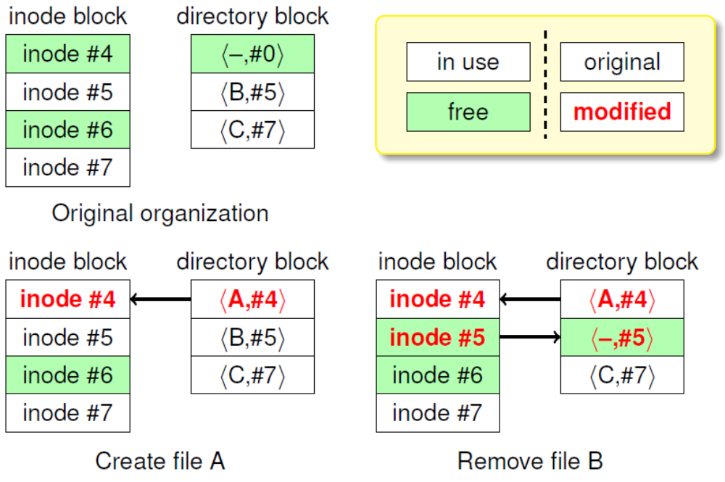
Cyclic Dependencies Illustrated

Slide 29
Soft Updates [Ganger]
Write blocks in any order
Keep track of dependencies
When writing a block, unroll any changes you can’t yet commit to disk

Slide 30
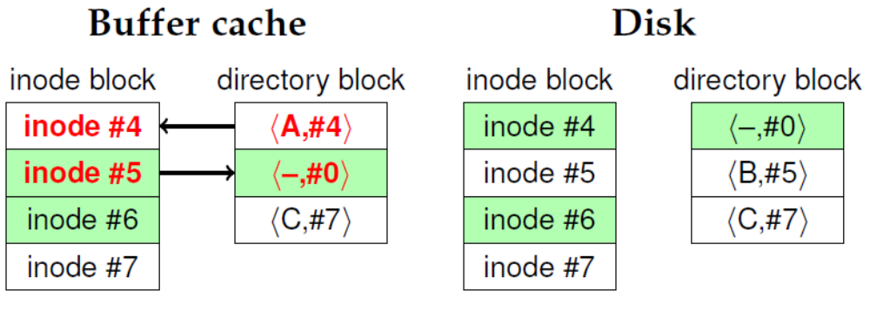
Breaking Dependencies
Created file A and deleted file B
Now say we decide to write directory block
Can’t write file name A to disk – has dependee

Slide 31
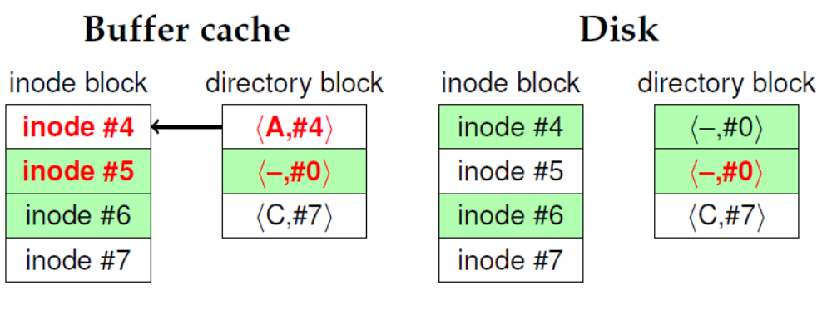
Breaking Dependencies
Undo file A before writing dir block to disk
But now inode block has no dependees
  Can safely write inode block to disk as-is

Slide 32
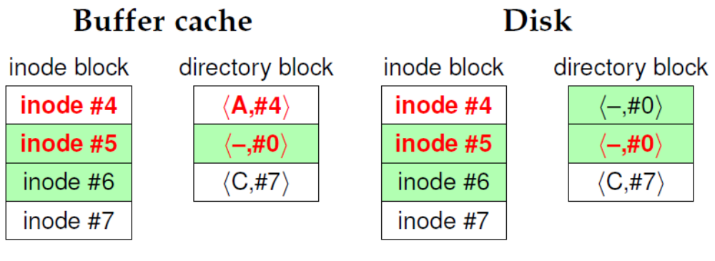
Breaking Dependencies
Now inode block clean (same in memory/disk)
But have to write directory block a second time

Slide 33
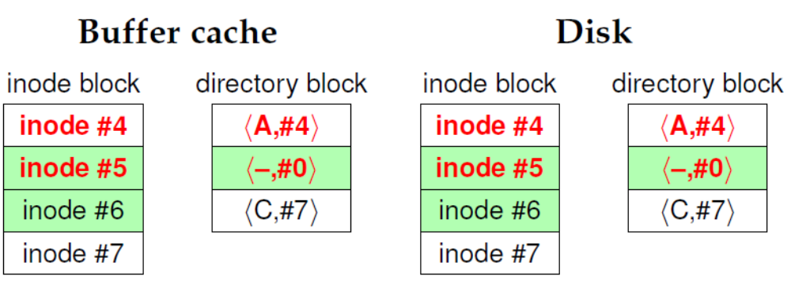
Breaking Dependencies
All data stably on disk
Crash at any point would have been safe

Slide 34
Soft Update Issues
fsync: May flush directory entries, etc.
unmount: Some disk buffers flushed multiple times
Deleting directory tree fast!
  unlink doesn’t need to read file inodes synchronously
  Careful with memory!
Useless write backs
  Syncer flushes dirty buffers to disk every 30 seconds
  Writing all at once means many dependency issues
  Fix syncer to write blocks one at a time
  LRU buffer eviction needs to know about dependencies

Slide 35
Soft Updates: fsck
Split into foreground + background parts
Foreground must be done before remounting
  Ensure per-cylinder summary makes sense
  Recompute free block/inode counts from bitmap (fast)
  Leave FS consistent but may leak disk space
Background does traditional fsck
  Done on a snapshot while system is running
  A syscall allows fsck to have FFS patch file system
  Snapshot deleted once complete
Much shorter downtimes than traditional fsck

Slide 36
Outline
Overview
FFS Review and Details
Crash Recoverability
Soft Updates
Journaling
LFS/WAFL

Slide 37
Journaling
Idea: Use Write-Ahead Log to Journal Metadata
  Reserve portion of the disk
  Write operation to log, then to the disk
  After a crash/reboot, replay the log (efficient)
  May redo already committed changes, but doesn’t miss
Physical Journal: Both data + metadata written
  Induces extra IO overhead to disk
  Simple to implement and safe for application
Logical Journal: Only metadata written to journal
  Metadata journaling
  More complex implementation

Slide 38
Journaling (Continued)
Performance Advantage:
  Log is a linear region of the disk
  Multiple operations can be logged
  Final operations written asynchronously
Journals typically large (~1 GB)
  Copy of disk blocks written
  Requires high throughput
Example: Deleting directory tree
  Journal all freed blocks, changed directory blocks, etc
  Return to user
  In background we can write out changes in any order

Slide 39
SGI XFS: [Sweeney]
Main idea:
  Big disks, files, and large # of files, 64-bit everything
  Maintain very good performance
Break disk up into Allocation Groups (AGs)
  0.5 – 4 GB regions of a disk
  Similar to Cylinder-Groups but for different purpose:
  AGs too large to minimize seek times
  AGs have no fixed # of inodes
Advantages:
  Parallelize allocation, and data structures for multicore
  Used on super computers with many cores
  32-bit pointers within AGs for size

Slide 40
XFS B+ Trees
XFS makes extensive use of B+ Trees
  Indexed data structure stores ordered keys & values
  Keys have defined ordering
Three main operations O(log(n))
  Insert a new <key, value> pair
  Delete <key, value> pair
  Retrieve closest <key, value> to target key k
  See any algorithms book for details
Used to:
  Free space management
  Extended attributes
  Extent map for files: file offset to <start, length>

Slide 41
B+ Trees Continued
Space Allocation:
  Two B+ Trees: Sorted by length, Sorted by address
  Easily find nearby blocks easily (locality)
  Easily find large extents for large files (best fit)
  Easily coalesce adjacent free regions
Journaling enables complex atomic operations
  First write metadata changes to log on-disk
  Apply changes to disk
  On Crash:
    If log is incomplete, log will be discarded
    Otherwise replay log

Slide 42
Journaling vs. Soft Updates
Limitations of Soft Updates
  High complexity and very tied to FFS data format
  Metadata updates may proceed out of order
    create A, create B, crash – maybe only B exists after reboot
  Still need slow background fsck
Limitations of Journaling
  Disk write required for every metadata operation
    Create-then-delete may not require I/Os with soft updates
  Possible contention for the end of log on multiprocessor
  fsync must sync other operations’ metadata to log
Can we get the best of both worlds?

Slide 43
Soft Updates + Journaling [McKusick]
Example of minimalist Metadata Journaling
Journal resource allocations and future references
fsck can recover file system state from journal
16 Mb journal (instead of GBs for data journals)
32 byte journal entries
27 types of journal entries
Fast fsck takes ~2 seconds
Less bandwidth and cost than normal journaling

Slide 44
Outline
Overview
FFS Review and Details
Crash Recoverability
Soft Updates
Journaling
LFS/WAFL

Slide 45
Log File System [Mendel]
Main Idea: Only have a journal!
Fast writing
  Fragmentation from long lived data may be a problem
Slow reading (lots of seeks)
  Finding the head of the file system may take time
Log cleaning:
  A process needs to periodically free old blocks from the file system
SSDs reduce seek overhead – LFS practical again

Slide 46
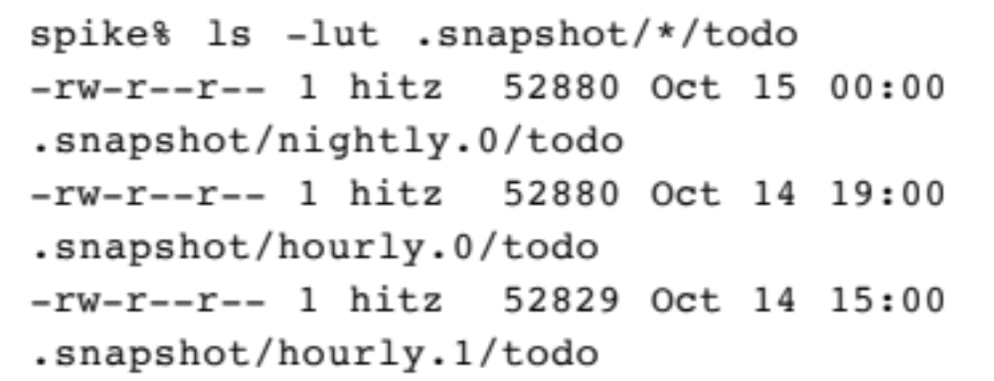
Write Anywhere File Layout (WAFL)
Copy-on-Write File System
Inspired ZFS, HAMMER, btrfs
Core Idea: Write whole snapshots to disk
Snapshots are virtually free!
Snapshots accessible from .snap directory in root

Slide 47
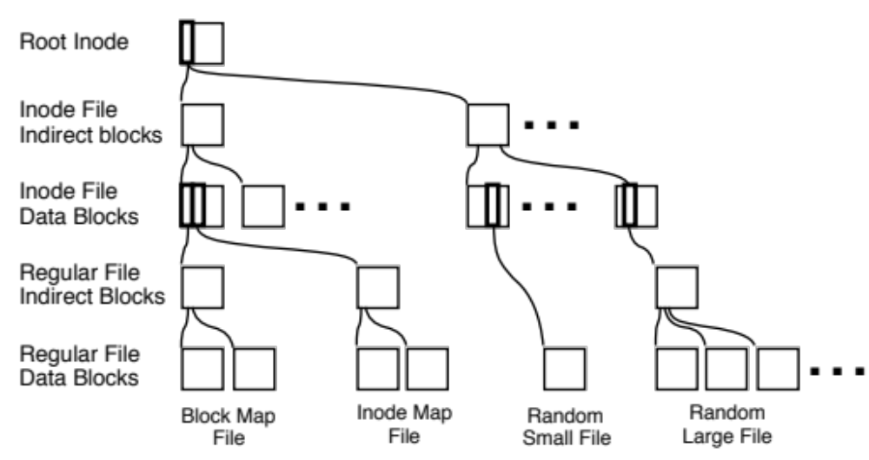
WAFL: Detailed View
Only root at fixed location
FS structures are accessed through Inodes
  Block allocation, Inode Table, Files, Directories

Slide 48
WAFL: Example
Consistency:
  On crash recovery find a snapshot that has been fully committed to disk
  Reclaim space after whole snapshot written to disk
Persistent Snapshots:
  Save root inode and do not reclaim data older than latest snapshot
Root Inode (1)
Root
Inode (2)
Inode
File
Inode
File
Indirect
File Block
Indirect
File Block
COPY
File
Block 0
File
Block 0
File
Block 1

Slide 49
ZFS
Copy-on-Write functions similar to WAFL
Integrates Volume Manager & File System
  Software RAID without the write hole
Integrates File System & Buffer Management
  Advanced prefetching: strided patterns etc.
  Use Adaptive Replacement Cache (ARC) instead of LRU
File System reliability
  Check summing of all data and metadata
  Redudant Metadata

Slide 50
RAID Write Hole
File A
⊕
File B
⊕
File C
=
Parity
Disk 1
Disk 2
Disk 3
Disk 4
Result: No way to distinguish between this and silent data corruption

Slide 51
ZFS Volume Management
Volume management and RAID part of ZFS
Checksums can identify:
  Silent data corruption
  RAID striped data not written in entirety
File system verifies recent snapshots on mount to fix write hole issues
If only one drive’s data is corrupt we don’t lose data

Slide 52
Redudant Metadata [zfs(8)]
Copies
Importance
4-Copies
Copies ideally placed on different disks
Uberblock
3 Copies
Znode
Znode
Znode
2 Copy
Directory
Indirect
Block
Double Indirect
Block
Data
Indirect
Block
Data

Slide 53
Summary
Performance & Recoverability Trade-off
fsck: Metadata overhead, fsck very slow
Soft Updates: Background recovery, low overhead
Journaling: Fast recovery, low overhead
Soft Updates + Journaling
  Fast recovery, low overhead
LFS/WAFL
  Fast writing/Higher read costs
  Almost no recovery time!

Slide 54
Cluster/Distributed File System
Shared Disk Cluster File Systems
  VxFS (JFS in HP-UX) – Clusters
    Network based locking
  VMFS – VMware’s clustering FS
    Uses SCSI reservations to coordinate between nodes
Local Disk Cluster
  GFS, Ceph, Lustre, Windows DFS
Both
  IBM GPFS

